Slide 1
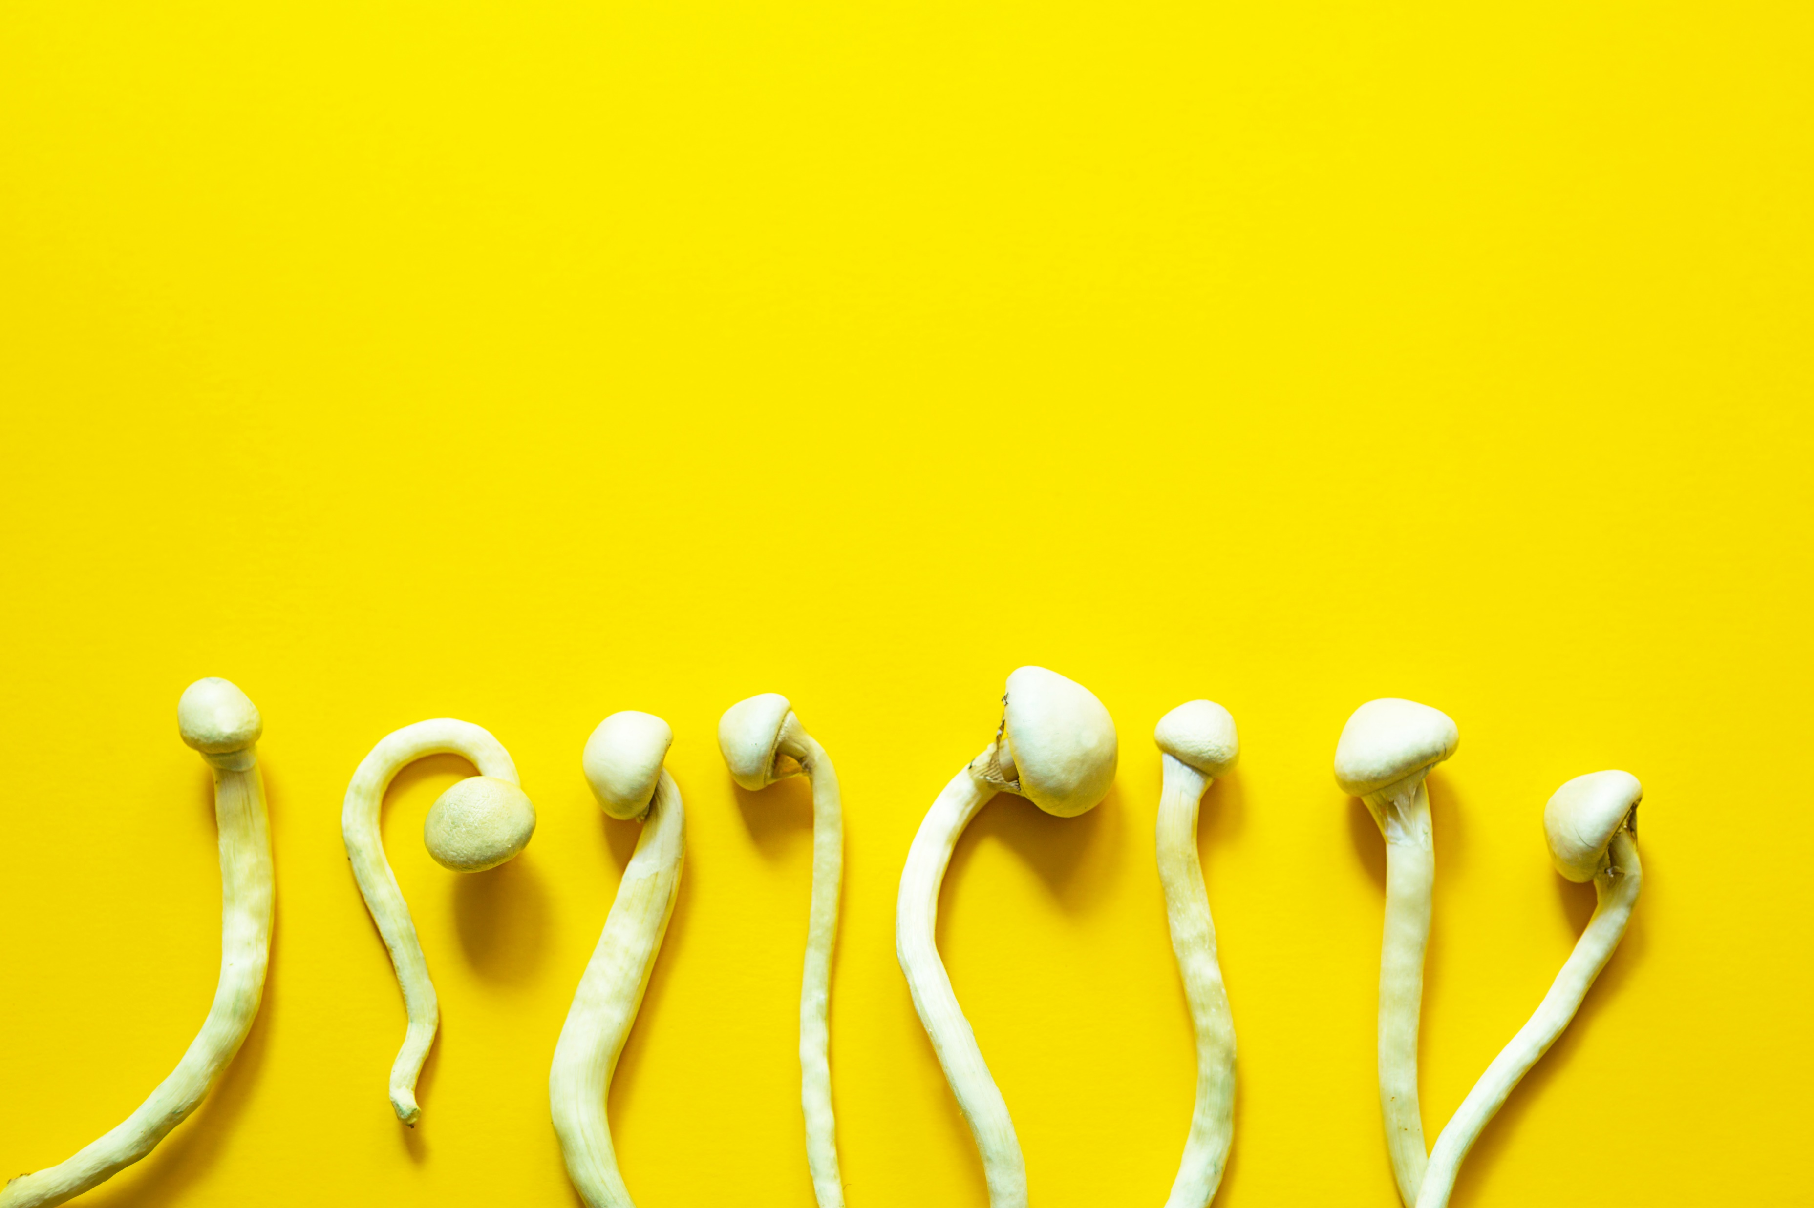
The Role of Psilocybin in Modern Psychiatric Medicine
Adam Clark, PA-S
University of St. Francis

Slide 2
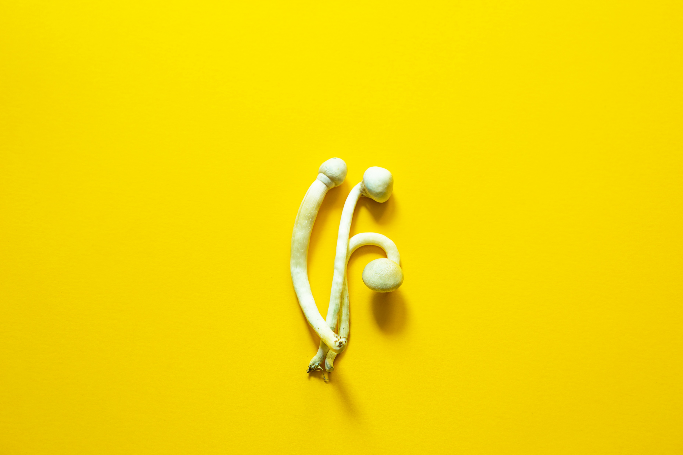
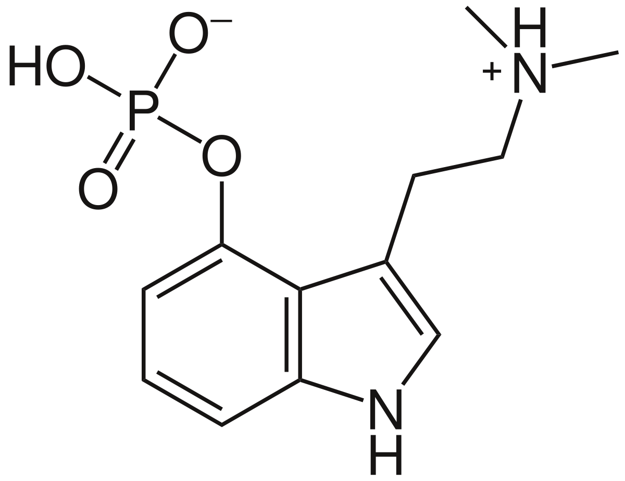
What is Psilocybin?
Psilocybe genus mushrooms
Psilocin, Baeocystin, and
Norbaeocystin^{1,2}
5HT_{2A} serotonin receptors
Notes:
Psilocybin is a prodrug in mushrooms of the Psilocybe genus, meaning that it doesn’t do anything until it’s metabolized. Once metabolized, psilocin, baeocystin, and norbaeocystin produce the psychedelic effects these mushrooms are known for. Of these, psilocin has the most potent and well-established effect. For the sake of simplicity, I’ll be using the term “psilocybin” from now on but keep in mind that psilocybin itself produces no effect.

Slide 3
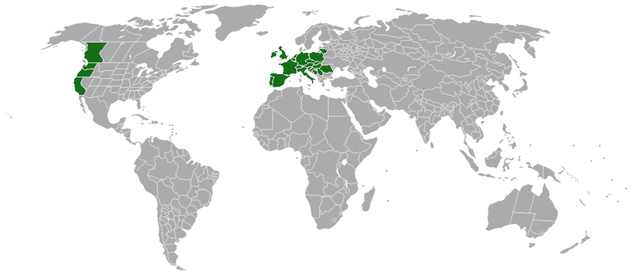
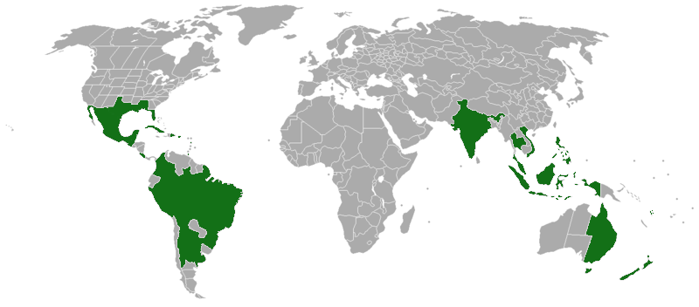
Global Distribution
P. cyanescens
P. cubensis
Guzman G, Allen J, Gartz J. A worldwide geographical distribution of the neurotropic fungi, an analysis and discussion. Ann Mus Civ Rovereto. 1998;14:189-280
Notes:
Remarkably, Psilocybe mushrooms have a global distribution, and all contain psilocybin. Seen here is the distribution of just two species of Psilocybe. There are over 150 species within this genus, and they are found wherever there are people;

Slide 4
Traditional Use and the West
Thousands of years of indigenous use^{7,8}
Banning by colonization^{8,10}
Spanish colonization of Mexico began in 1521.
Introduction to the West⁹
^{Robert Gordon Wasson, 1955}
Artwork courtesy of Girish Chandok @girishchandok on IG
Notes:
Hallucinogens have been used ritualistically by indigenous cultures around the world throughout human history. In Mexico, Aztec people used psilocybin mushrooms for purposes such as divining the outcome of battles. Use of hallucinogenic mushrooms in Mexico goes back hundreds if not thousands of years.
During the age of discovery, Spanish imperialists in Mexico actively sought to snuff out mushroom use, referring to it as a “devil”⁷ and that the practice of using them was “idolatrous”⁵.
Mushroom use then disappeared from Western consciousness for four hundred years, until 1955 when a banker named Robert Gordon Wasson gained the trust of a woman named Maria Sabina who lived in Huatla de Jimenez, Mexico and told her he was trying to locate his missing son so that she would give him the mushrooms. After this experience Wasson wrote an article that was published in LIFE Magazine, which sparked immediate and enormous interest in this mushroom and by 1970, Huatla was flooded with mushroom seeking tourists, prompting Maria Sabina’s neighbors to burn down her house and imprisoner her, blaming her for this influx of unwelcomed guests.

Slide 5
Early Studies and Banning
Early studies¹⁰
Spilling into the public¹⁰
DEA and the Controlled Substance Act (1970)¹¹
Notes:
Early studies lacked rigor and proper methodology, and there are even instances of tampering with the data to show more favorable outcomes. PubMed shows 232 studies done with psilocybin between 1958 and 1970 and yet we do not tend to reference these studies in modern investigations.
As the 60s progressed, psychedelics became more and more popular in the mainstream. Figures like Timothy Leary (whom Nixon called the most dangerous man in America) were highly publicized, and the media reported on the alleged dangers of taking these substances with headlines such as “Thrill Drug Warps Mind, Kills”.
In 1970 the DEA was established with the passing of the Controlled Substance Act, which meant that drugs now fell under a category of scheduling. They determined that psilocybin was schedule 1, meaning that “The drug or other substance has a high potential for abuse. The drug or other substance has no currently accepted medical use in treatment in the United States. And that there is a lack of accepted safety for use of the drug or other substance under medical supervision.”
We will discover whether or not this scheduling is appropriate as we go through the rest of this presentation.
According to Johnson and Griffiths, there has been “a steady revival of human psychedelic research”. (Johnson MW, Griffiths RR. Potential Therapeutic Effects of Psilocybin. Neurotherapeutics. 2017;14(3):734-740. doi:10.1007/s13311-017-0542-y)

Slide 6
A Comeback
FDA Breakthrough Therapy
John’s Hopkins Center for Psychedelic and Consciousness Research
Multidisciplinary Association for Psychedelic Studies (MAPS)
Heffter Research Institute
Nikean Psychedelic Psychotherapy Research Centre
Mass General Center for the Neuroscience of Psychedelics
Notes:
Despite remaining a schedule 1 drug, the FDA designated psilocybin a “breakthrough therapy” for depression in 2018 which has opened venues for more researchers to conduct studies using psilocybin. Research centers have been opened that are dedicated to the study of psilocybin and other psychedelics including John’s Hopkins Center for Psychedelic and Consciousness Research, the Multidisciplinary Association for Psychedelic Studies (MAPS) which has actually been in operation since 1986, the Heffter Research Institute, and the Nikean Psychedelic Psychotherapy Research Centre in Canada.

Slide 7
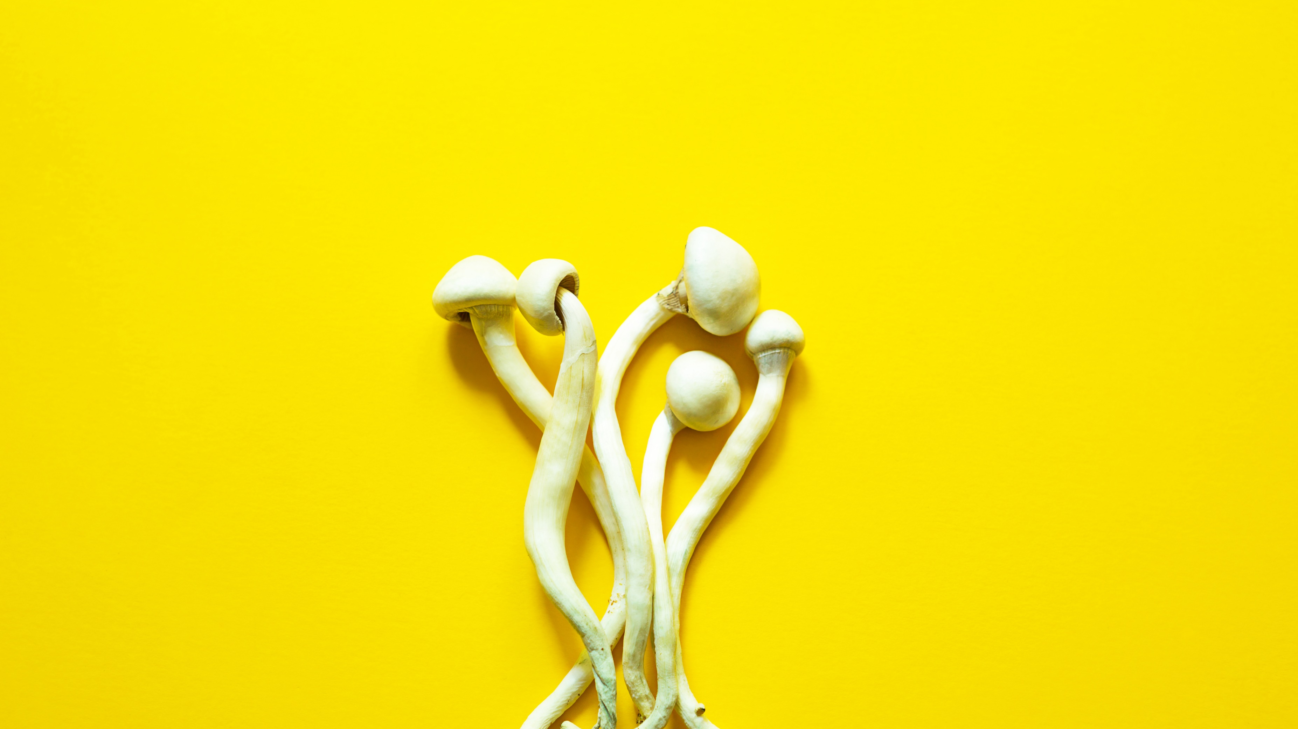
Areas of Research
Depression¹²⁻¹⁷
Suicidal ideation¹⁷
Terminal illness¹⁸⁻²⁰
Concussion
Lyme Disease
Tobacco Cessation^{21,22}
Alcohol Use Disorder^{23,24}
OCD, Anxiety, PTSD
Anorexia
Alzheimer’s Disease

Slide 8
Contraindications
Psychosis/Psychotic Disorders
Interactions with medications?
Hypertension
Possibly more that we have not yet discovered.

Slide 9
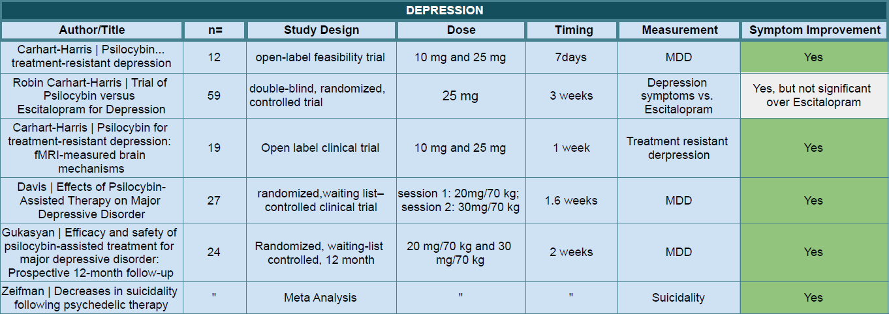
Depression

Slide 10
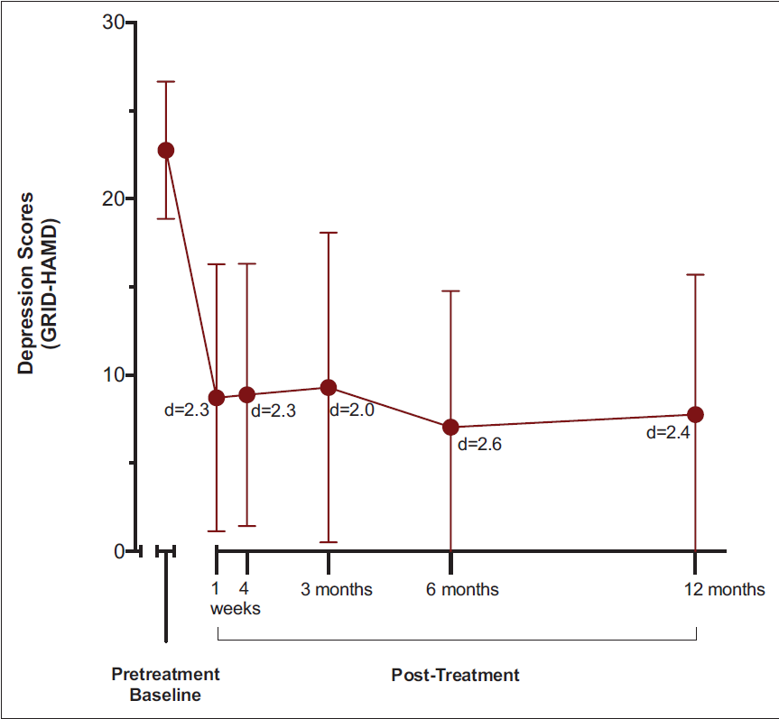
Results: Depression
Gukasyan N, Davis AK, Barrett FS, et al. Efficacy and safety of psilocybin-assisted treatment for major depressive disorder: Prospective 12-month follow-up. J Psychopharmacol (Oxf). 2022;36(2):151-158. doi:10.1177/02698811211073759
Notes:
p = <0.001

Slide 11
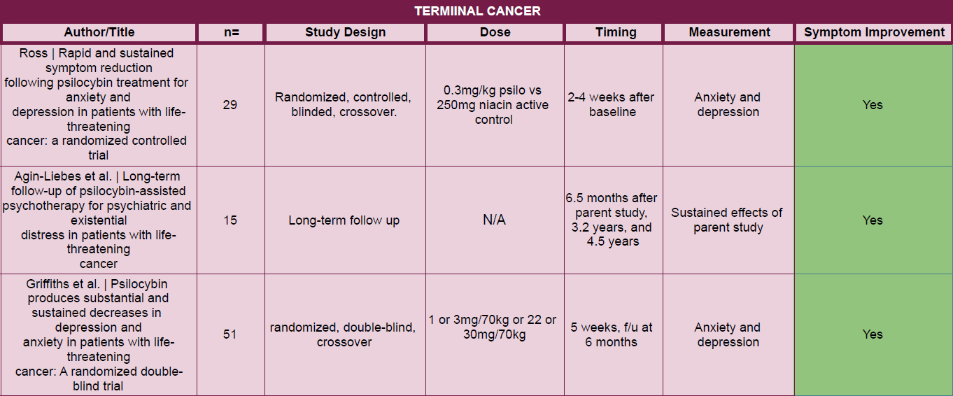
Terminal Illness
Notes:
This is what granted breakthrough approval

Slide 12
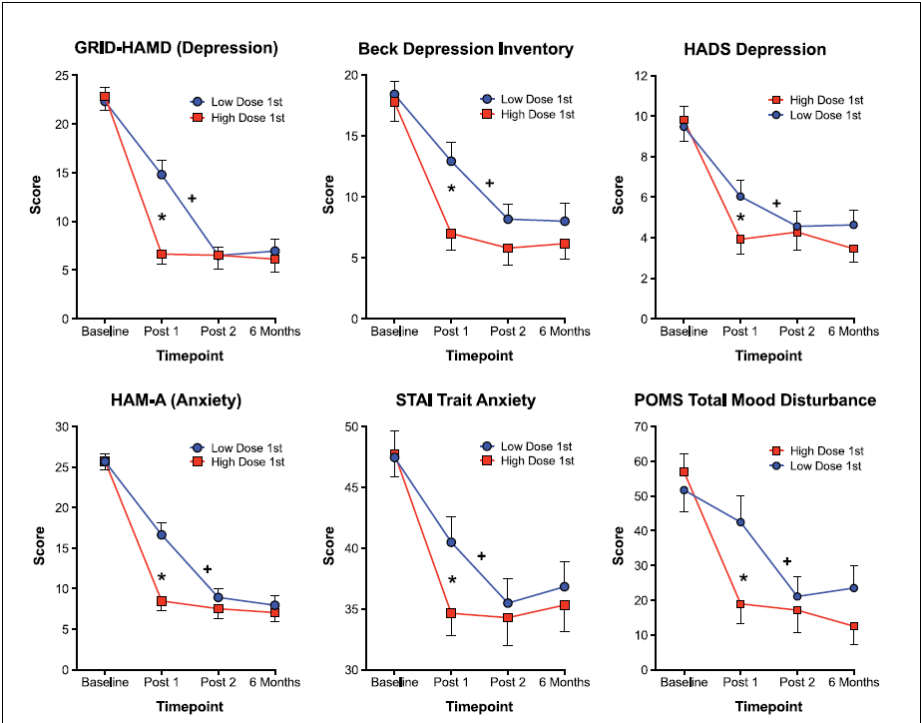
Griffiths RR, Johnson MW, Carducci MA, et al. Psilocybin produces substantial and sustained decreases in depression and anxiety in patients with life-threatening cancer: A randomized double-blind trial. J Psychopharmacol (Oxf). 2016;30(12):1181-1197. doi:10.1177/0269881116675513
Notes:
Star symbol indicates a significant difference between the two groups at the Post-session 1 time-point (p<0.05, planned comparison). Cross symbol indicates a significant difference between the Post-session 1 and Post-session 2 time-points in the Low-Dose-1st (High-Dose-2nd) Group (p<0.05, planned comparison).

Slide 13
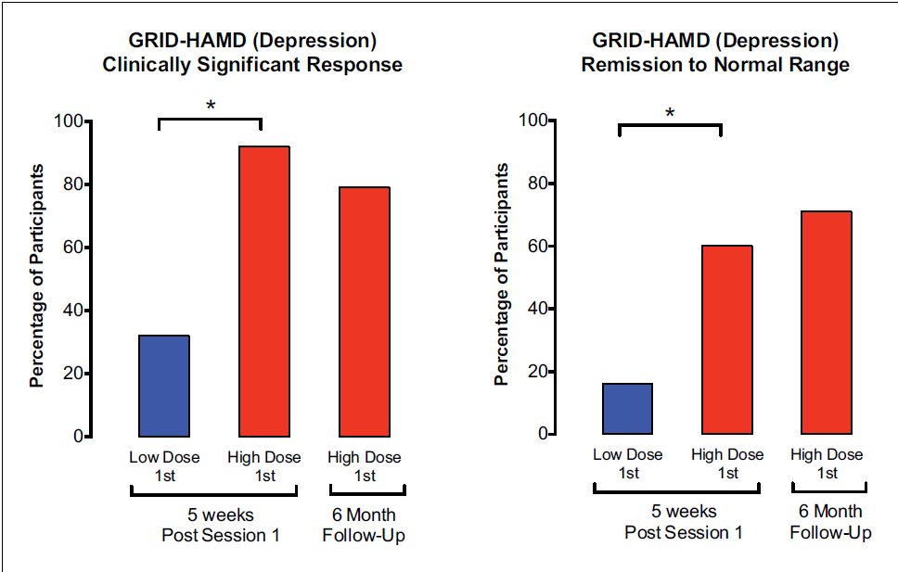
Griffiths RR, Johnson MW, Carducci MA, et al. Psilocybin produces substantial and sustained decreases in depression and anxiety in patients with life-threatening cancer: A randomized double-blind trial. J Psychopharmacol (Oxf). 2016;30(12):1181-1197. doi:10.1177/0269881116675513
Notes:
Response to treatment means that the patient is showing symptom improvement, and remission indicates that symptoms have been mostly alleviated.

Slide 14
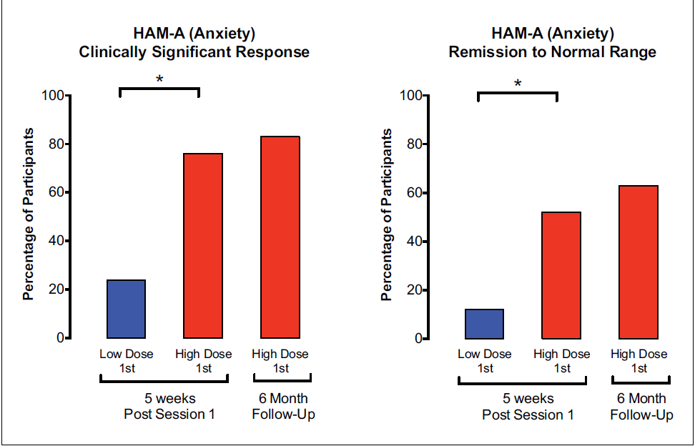
Griffiths RR, Johnson MW, Carducci MA, et al. Psilocybin produces substantial and sustained decreases in depression and anxiety in patients with life-threatening cancer: A randomized double-blind trial. J Psychopharmacol (Oxf). 2016;30(12):1181-1197. doi:10.1177/0269881116675513

Slide 15
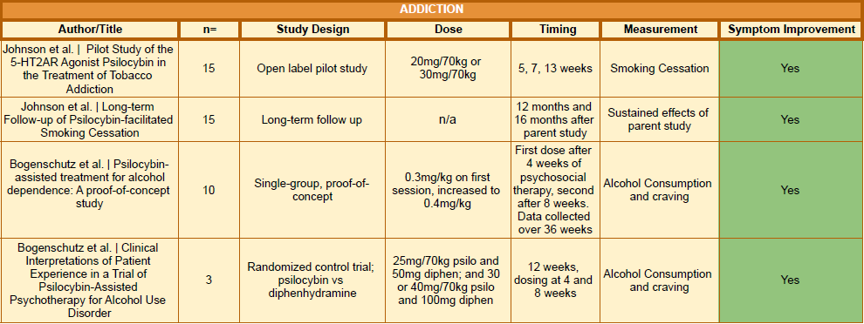
Substance Use Disoders
Notes:
Discuss smoking cessation studies here. Compare with o

Slide 16
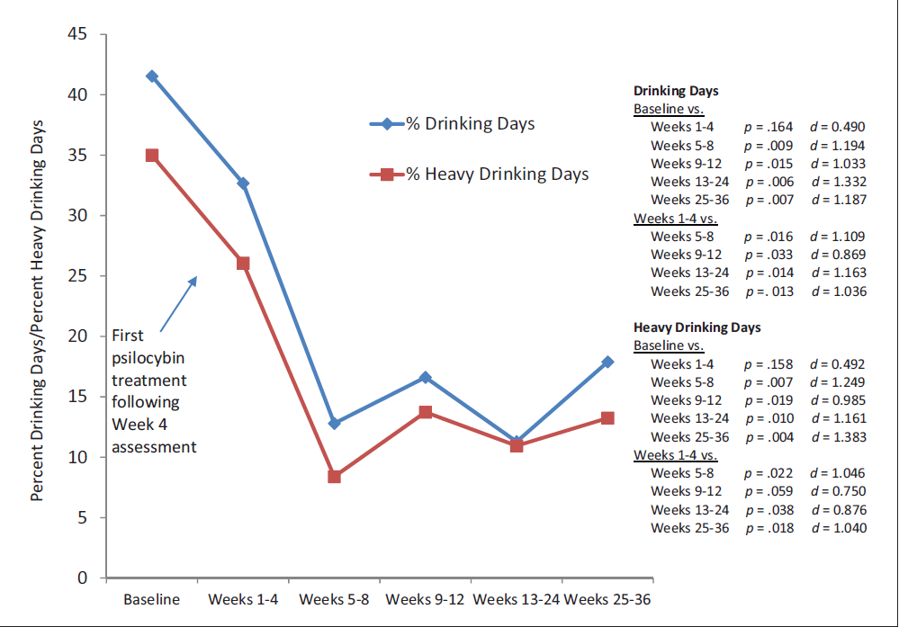
Bogenschutz MP, Forcehimes AA, Pommy JA, Wilcox CE, Barbosa P, Strassman RJ. Psilocybin-assisted treatment for alcohol dependence: A proof-of-concept study. J Psychopharmacol (Oxf). 2015;29(3):289-299. doi:10.1177/0269881114565144

Slide 17
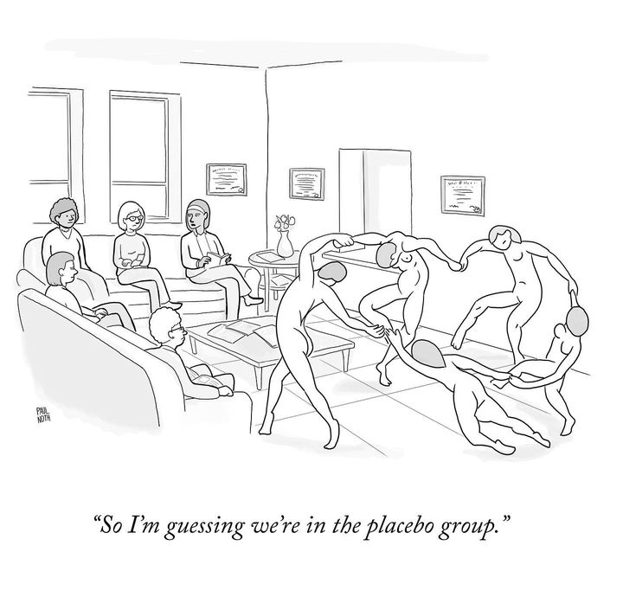
Limitations

Slide 18
Limitations
Small sample size
Not generalizable
Lack of control group
Limited blinding
Notes:
Limitations: Small sample size, lack of control group or blinding, lack of biological verification of alcohol use.

Slide 19
Conclusions
Safety:
Safe
Efficacy:
Effective
Notes:
Limitations: Small sample size, lack of control group or blinding, lack of biological verification of alcohol use.

Slide 20
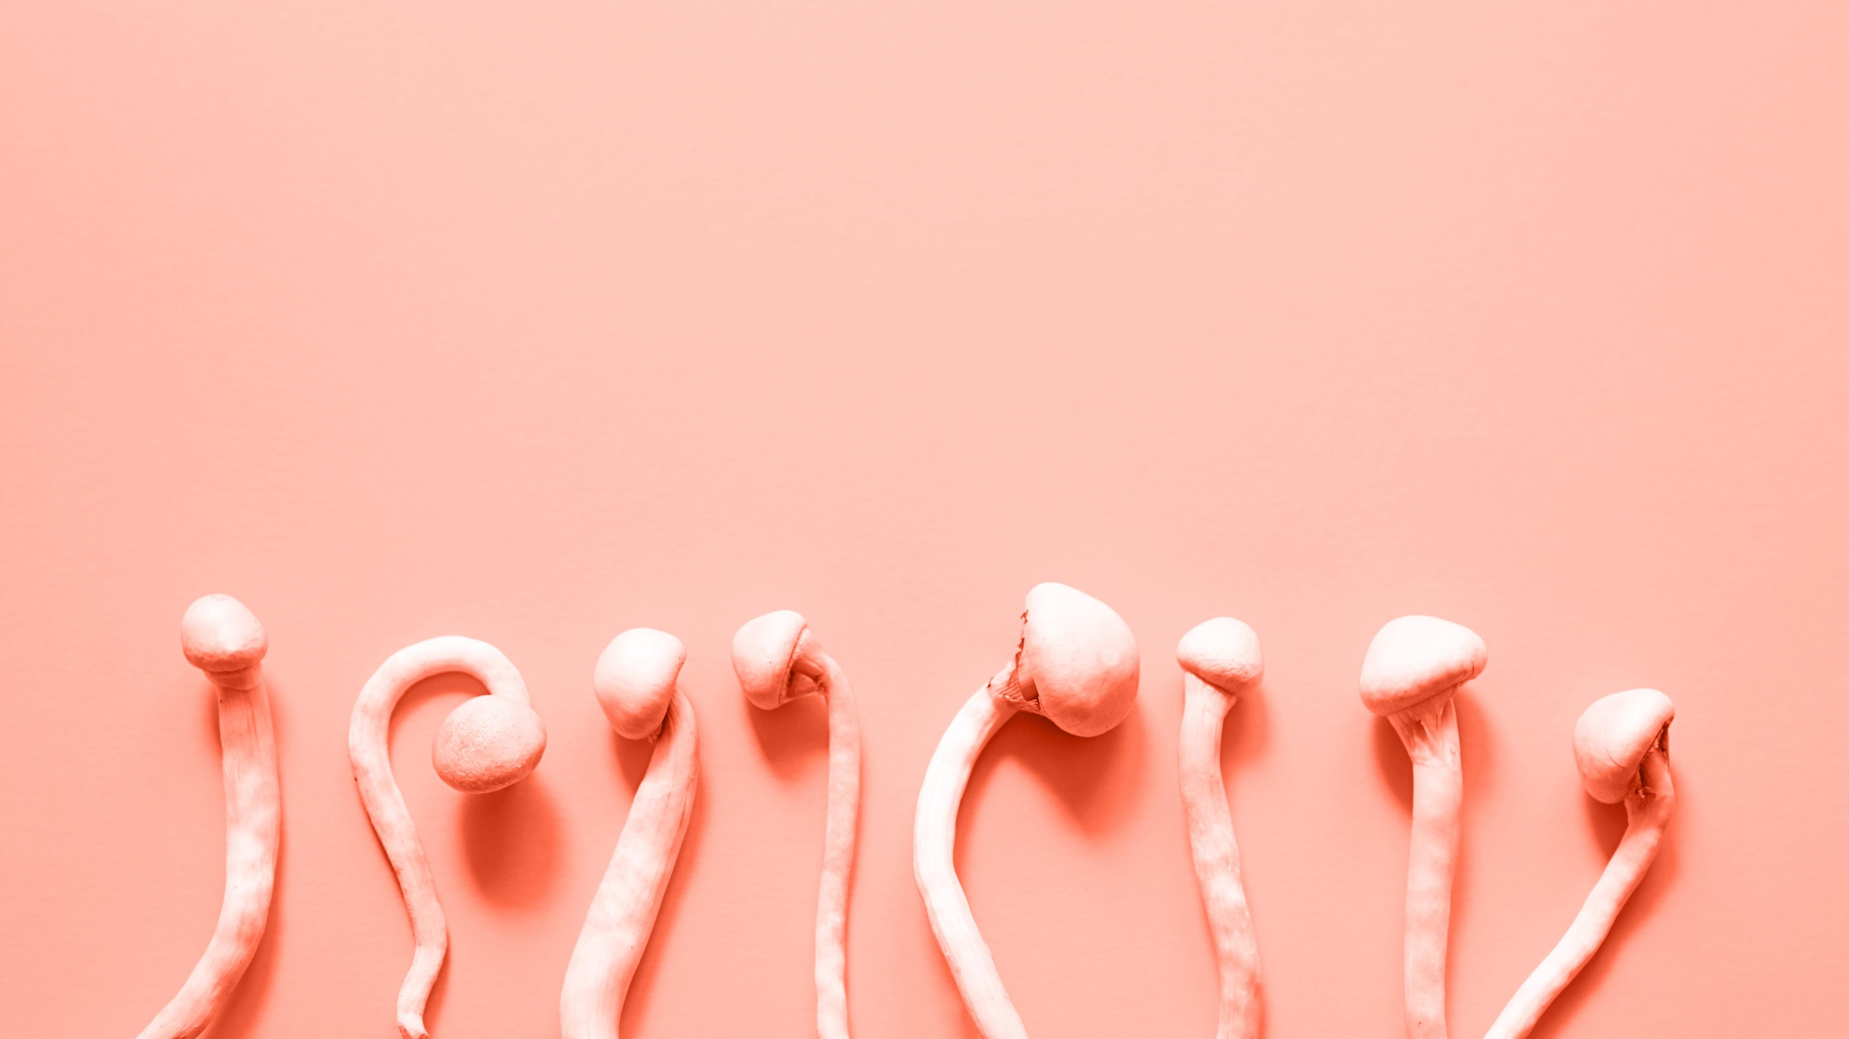
Conclusion
DEA Schedule I Criteria:
The drug or other substance has a high potential for abuse.
The drug or other substance has no currently accepted medical use in treatment in the United States.
There is a lack of accepted safety for use of the drug or other substance under medical supervision.

Slide 21
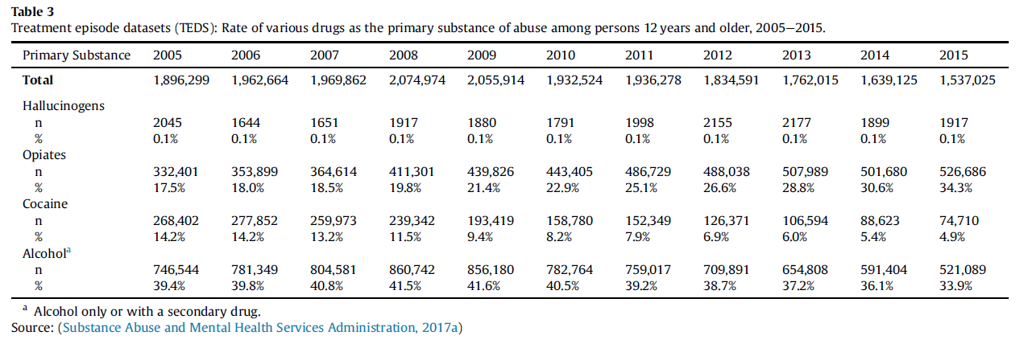
Conclusion

Slide 22
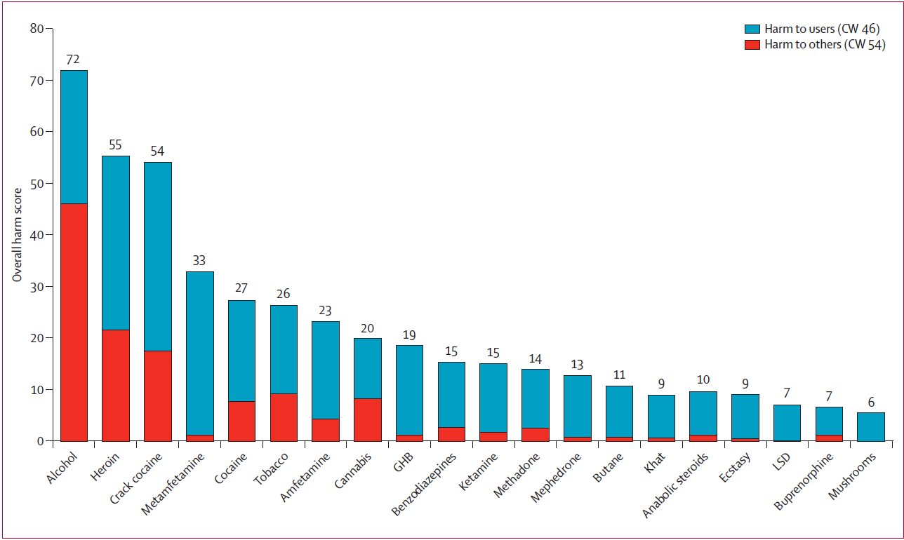
Nutt DJ, King LA, Phillips LD. Drug harms in the UK: a multicriteria decision analysis. The Lancet. 2010;376(9752):1558-1565. doi:10.1016/S0140-6736(10)61462-6
Notes:
“cumulative in the sense of the sum of all the normalised weights for all the criteria to users, 46; and for
all the criteria to others, 54”

Slide 23
Thank You

Slide 24
References
1. Horita A, Weber LJ. Dephosphorylation of Psilocybin to Psilocin by Alkaline Phosphatase. Exp Biol Med. 1961;106(1):32-34. doi:10.3181/00379727-106-26228
2. Leung AY, Paul AG. Baeocystin and Norbaeocystin: New Analogs of Psilocybin from Psilocybe baeocystis. J Pharm Sci. 1968;57(10):1667-1671. doi:10.1002/jps.2600571007
3. Guzman G, Allen J, Gartz J. A worldwide geographical distribution of the neurotropic fungi, an analysis and discussion. Ann Mus Civ Rovereto. 1998;14:189-280.
4. Molecule of the Week Archive: Psilocybin. Published October 2, 2018. https://www.acs.org/content/acs/en/molecule-of-the-week/archive/p/psilocybin.html#:~:text=In%201958%2C%20Swiss%20chemist%20Albert,%E2%80%9Cfather%20of%20LSD%E2%80%9D.)
5. Nichols DE. Psychedelics. Barker EL, ed. Pharmacol Rev. 2016;68(2):264-355. doi:10.1124/pr.115.011478
6. Sherwood AM, Halberstadt AL, Klein AK, et al. Synthesis and Biological Evaluation of Tryptamines Found in Hallucinogenic Mushrooms: Norbaeocystin, Baeocystin, Norpsilocin, and Aeruginascin. J Nat Prod. 2020;83(2):461-467. doi:10.1021/acs.jnatprod.9b01061
7. Carod-Artal FJ. Alucinógenos en las culturas precolombinas mesoamericanas. Neurología. 2015;30(1):42-49. doi:10.1016/j.nrl.2011.07.003
8. Letcher A. Feasts and Revelations. In: Shroom: A Cultural History of the Magic Mushroom. Reprint. Ecco; 2008:74-77.
9. Gordon Wasson R. Seeking the Magic Mushroom. LIFE Mag. 1957;42(19):100-110, 113-114, 117-118, 120.
10. Pollan M. In: How to Change Your Mind: What the New Science of Psychedelics Teaches Us About Consciousness, Dying, Addiction, Depression, and Transcendence. Penguin Press; 2018.
11. Controlled Substance Act. https://www.law.cornell.edu/uscode/text/21/812
12. Carhart-Harris RL, Roseman L, Bolstridge M, et al. Psilocybin for treatment-resistant depression: fMRI-measured brain mechanisms. Sci Rep. 2017;7(1):13187. doi:10.1038/s41598-017-13282-7
13. Carhart-Harris R, Giribaldi B, Watts R, et al. Trial of Psilocybin versus Escitalopram for Depression. N Engl J Med. 2021;384(15):1402-1411. doi:10.1056/NEJMoa2032994

Slide 25
References
14. Carhart-Harris RL, Bolstridge M, Rucker J, et al. Psilocybin with psychological support for treatment-resistant depression: an open-label feasibility study. Lancet Psychiatry. 2016;3(7):619-627. doi:10.1016/S2215-0366(16)30065-7
15. Gukasyan N, Davis AK, Barrett FS, et al. Efficacy and safety of psilocybin-assisted treatment for major depressive disorder: Prospective 12-month follow-up. J Psychopharmacol (Oxf). 2022;36(2):151-158. doi:10.1177/02698811211073759
16. Davis AK, Barrett FS, May DG, et al. Effects of Psilocybin-Assisted Therapy on Major Depressive Disorder: A Randomized Clinical Trial. JAMA Psychiatry. 2021;78(5):481. doi:10.1001/jamapsychiatry.2020.3285
17. Zeifman RJ, Yu D, Singhal N, Wang G, Nayak SM, Weissman CR. Decreases in Suicidality Following Psychedelic Therapy: A Meta-Analysis of Individual Patient Data Across Clinical Trials. J Clin Psychiatry. 2022;83(2). doi:10.4088/JCP.21r14057
18. Ross S, Bossis A, Guss J, et al. Rapid and sustained symptom reduction following psilocybin treatment for anxiety and depression in patients with life-threatening cancer: a randomized controlled trial. J Psychopharmacol (Oxf). 2016;30(12):1165-1180. doi:10.1177/0269881116675512
19. Agin-Liebes GI, Malone T, Yalch MM, et al. Long-term follow-up of psilocybin-assisted psychotherapy for psychiatric and existential distress in patients with life-threatening cancer. J Psychopharmacol (Oxf). 2020;34(2):155-166. doi:10.1177/0269881119897615
20. Griffiths RR, Johnson MW, Carducci MA, et al. Psilocybin produces substantial and sustained decreases in depression and anxiety in patients with life-threatening cancer: A randomized double-blind trial. J Psychopharmacol (Oxf). 2016;30(12):1181-1197. doi:10.1177/0269881116675513
21. Johnson MW, Garcia-Romeu A, Cosimano MP, Griffiths RR. Pilot study of the 5-HT _{2A} R agonist psilocybin in the treatment of tobacco addiction. J Psychopharmacol (Oxf). 2014;28(11):983-992. doi:10.1177/0269881114548296
22. Johnson MW, Garcia-Romeu A, Griffiths RR. Long-term follow-up of psilocybin-facilitated smoking cessation. Am J Drug Alcohol Abuse. 2017;43(1):55-60. doi:10.3109/00952990.2016.1170135
23. Bogenschutz MP, Forcehimes AA, Pommy JA, Wilcox CE, Barbosa P, Strassman RJ. Psilocybin-assisted treatment for alcohol dependence: A proof-of-concept study. J Psychopharmacol (Oxf). 2015;29(3):289-299. doi:10.1177/0269881114565144
24. Bogenschutz MP, Podrebarac SK, Duane JH, et al. Clinical Interpretations of Patient Experience in a Trial of Psilocybin-Assisted Psychotherapy for Alcohol Use Disorder. Front Pharmacol. 2018;9:100. doi:10.3389/fphar.2018.00100
25. Johnson MW, Griffiths RR, Hendricks PS, Henningfield JE. The abuse potential of medical psilocybin according to the 8 factors of the Controlled Substances Act. Neuropharmacology. 2018;142:143-166. doi:10.1016/j.neuropharm.2018.05.012
26. Nutt D, Carhart-Harris R. The Current Status of Psychedelics in Psychiatry. JAMA Psychiatry. 2021;78(2):121. doi:10.1001/jamapsychiatry.2020.2171

Slide 26
Appendix

Slide 27
How Does it Work?
Default Mode Network
Functional Connectivity
Placebo
Notes:
Functional connectivity → same mechanism as ketamine for treatment
Default mode network hypothesis → Speed therapy!
^{Big ol placebo? Placebo plus?}
In an opinion piece written by David Nutt and Robin Carthart-Harris, they suggest that psychedelics work by "disrupting brain systems and circuits that encode these repetitive thoughts and behaviors"
They suggest that these are all internalizing disorders and that is why they are effectively treated by psilocybin therapy.

Slide 28
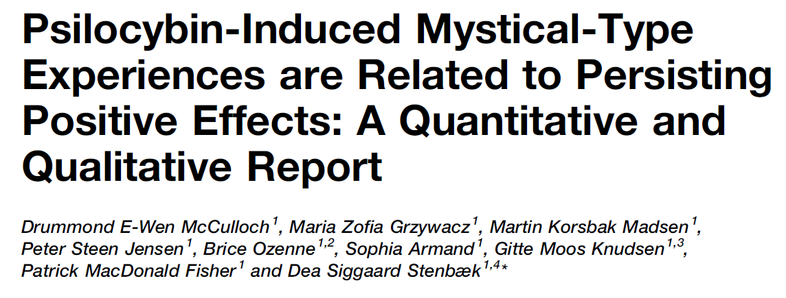
Healthy Volunteers
“In this paper we show a relation between the intensity of the psilocybin-induced mystical-type experience and lasting positive psychological effects and extend previous work by showing that the MEQ subscales Mysticality and Positive Mood were more closely associated with lasting positive effects than Transcendence of Time and Space or Ineffability. This suggests that the phenomenology of the psychedelic experience is relevant to lasting positive effects. Additionally, we provide the first extensive qualitative descriptions of orally administered psilocybin in healthy volunteers revealing themes including universal connectedness, experience of beauty, and familial love that may be used to inform future research utilising psilocybin in healthy volunteers.”

Slide 29
Microdosing
While small amounts of dried Psilocybe cubensis mushrooms reliably induced significant subjective effects, their impact in other domains was negligible or even indicative of impaired performance. Clearly, more research is needed to decide whether microdosing with psychedelics can deliver at least some of its promised positive effects.
Psilocybin microdosers demonstrate greater observed improvements in mood and mental health at one month relative to non‑microdosing controls
Joseph M. Rootman, Maggie Kiraga, Pamela Kryskow, Kalin Harvey, Paul Stamets, Eesmyal Santos‑Brault, Kim P. C. Kuypers & Zach Walsh
[The authors]identified small‑ to medium‑sized improvements in mood and mental health that were generally consistent across gender, age and presence of mental health concerns, as we all as improvements in psychomotor performance that were specific to older adults
Psilocybin microdosing does not affect emotion-related symptoms and processing: A preregistered field and lab-based study
Josephine Marschall, George Fejer, Pascal Lempe, Luisa Prochazkova, Martin Kuchar, Katerina Hajkova and Michiel van Elk
Our confirmatory analyses revealed that psilocybin microdosing did not affect emotion processing or symptoms of anxiety and depression compared with placebo.

Slide 30
Negative Effects
2020
2011
In conclusion, the use of magic mushrooms is relatively safe as only few and relatively mild adverse effects have been reported. The low prevalent but unpredictable provocation of panic attacks and flash-backs remain, however, a point of concern.
The results confirm psilocybin mushrooms are a relatively safe drug, with serious incidents rare and short lasting. Providing harm-reduction information likely plays a key role in preventing adverse effects. More research is needed to examine the detailed circumstances and predictors of adverse reactions including rarer physiological reactions.

